Slide 1







|| Jai Sri Gurudev ||
Sri Adichunchanagiri Shikshana Trust®
SJB INSTITUTE OF TECHNOLOGY
Department of Electronics & Communication Engineering
Phase-1
Presentation on
An Approach towards Development of Smart Aeroponic System
Batch 2
Presented By
Chethan S 1JB19EC022
Indupriya B 1JB19EC029
Kruthi N 1JB19EC041
Manjukishore P 1JB19EC050
Under the guidance of
Dr. Chandrappa D N
Professor & HOD
Dept. of ECE, SJBIT

Slide 2
CONTENTS
Introduction
Literature Survey
Motivation and Challenges
Objectives
Proposed Methodology
Block diagram and flowchart
References
Applications
Possible Outcome

Slide 3

INTRODUCTION
With the current global and local economic crisis, the word diversification is on everyone's mind and even though we are aware of the important role the agriculture sector played in our economy in the past, it has been difficult to really get the sector to grow as fast as the economy requires.
One of the most recent discoveries is Aeroponics a technology that proves plants do not require soil to grow, not only that but that soil may even inhibit swift and healthy growth of plants.
Aeroponics is the practice of growing plants in an air or mist environment without the use of any substrate.
That is, the plant roots are suspended in the air and are misted or sprayed periodically with a nutrient solution or aerosol of nutrient solution.
Water and nutrient use efficiency in an aeroponic system
Any species of plants can be grown in a true aeroponic system as the micro-environment of an aeroponic can be finely controlled. Aeroponic systems for seed production have been established following increased demand for more efficient high quality seed production methods.

Slide 4
LITERATURE SURVEY
Author name | Title | Year | Inference | Limitations
I.Nir | Apparatus and method for plant growth in aeroponic condition | 1977 | Automated mist spray. | Simple apparatus compared to sophisticated apparatus available in present market.
Y.W.Z.Jing Liu | An automated aeroponic growth system based on ultrasonic automization. | 2013 | Monitoring temperature conductivity. | Temperature monitoring only.
V.Arenella | Automatic aeroponic irrigation system based on Arduino platform. | 2016 | Real time data was logged and streamed to web server. | Data mining and analysis only.
Stephen C. Kerns Joong-Lyul Lee | Automated Aeroponics System Using IoT for Smart Farming | 2017 | Introduction of a new application using Raspberry pi zero | High cost. ESP32-S2 is used as an IOT device.
M Rakib Uddin and M F Suliaman | Energy efficient smart indoor fogponics farming system | 2021 | fog is produced by placing an ultrasonic fog generator | Fog generator produces more heat due to its usage which increases the temperature of the chamber

Slide 5

MOTIVATION
The declining availability of natural resources like water and arable land, unpredictable weather patterns and changing climates, and an exponentially growing population
With one in nine people still living in destitute hunger, the world awaits the next phase of the agricultural revolution.
Quick and disease-free plants are obtained as the roots of the plants are exposed to air and they can easily absorb the required oxygen level. However, the roots can also be sterilized by using mist on the roots to further prevent the plant diseases.
100% safe and environment-friendly. They conserve water and reduces the amount of human labor involved.

Slide 6
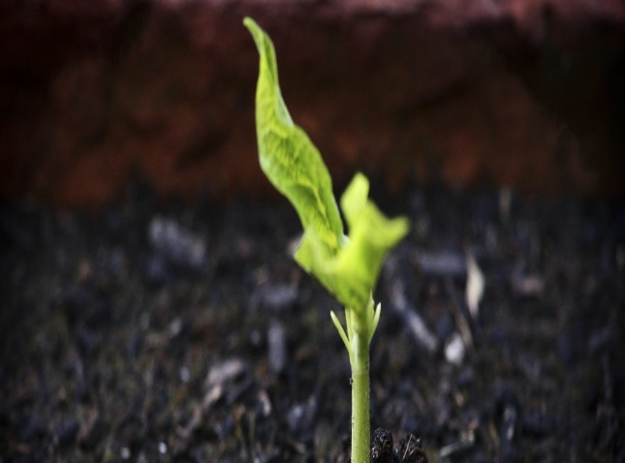

CHALLENGES
Technical knowledge required.
Sanitary conditions of the root chamber.
High cost
Power loss
Regular cleaning of the root
More than estimated time required.

Slide 7
OBJECTIVES
OBJECTIVES
Two different chambers will be developed one for the shoot system and the other for the root system. This is done to ensure that the climatic conditions of the root system and shoot system are completely independent of each other.
The goal of this project is to create a fully automated aeroponic and greenhouse system that will reduce the need for human interference to the maximum possible extent.
To monitor and regulate the interior environment and send the collected data over an internet connection which would process the data and display it to the user through a web interface, which will also be used to allow the user to control the aeroponic system.

Slide 8
PROPOSED METHODOLOGY
Shoot chamber: The shoot chamber will host a light sensor, temperature sensor, gas sensor with exhaust fan to regulate the air pressure and temperature in the chamber. An array of LED lights will be fixed to the zenith of the chamber and the brightness of these lights will be controlled according to the optimum light intensity required by different plants for photosynthesis. Temperature and humidity regulation is done using exhaust fan and sensors. The exhaust fan will reduce the temperature and humidity of the chamber if it increases above the optimum value. The gas sensor will regulate the amount of oxygen and Carbon dioxide present within the shoot chamber.
Root chamber: The root chamber will have its own sensors to regulate the temperature and humidity of the chamber. The nutrient reservoir will be constructed which comprises of nutrient solution, pH up and pH down solutions. These solutions will be supplied through solenoid valves. A couple of mixers in the reservoir will ensure that the composition of the nutrient solution within the reservoir stays consistent. A pH sensor and an EC sensor will monitor the pH and EC level of the solution respectively according to the needs of the plant. Water level sensor monitors the water level of the reservoir, and it will replenish the reservoir if the solution drops below the given level.

Slide 9
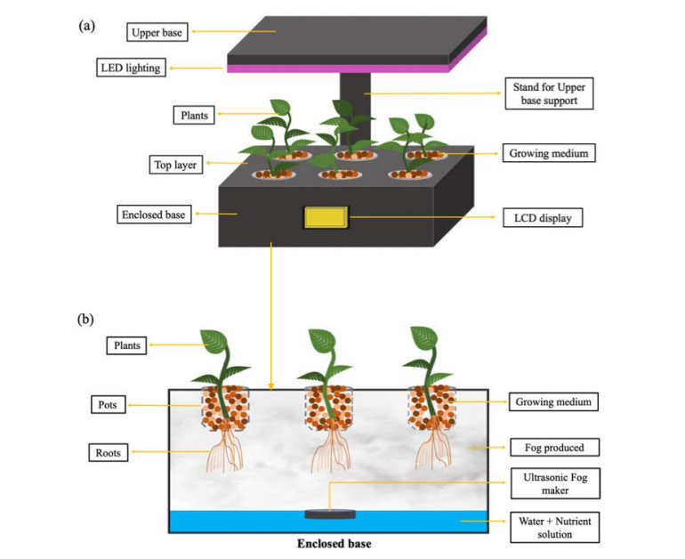
Block diagram
Mist produced
High pressure nozzle

Slide 10
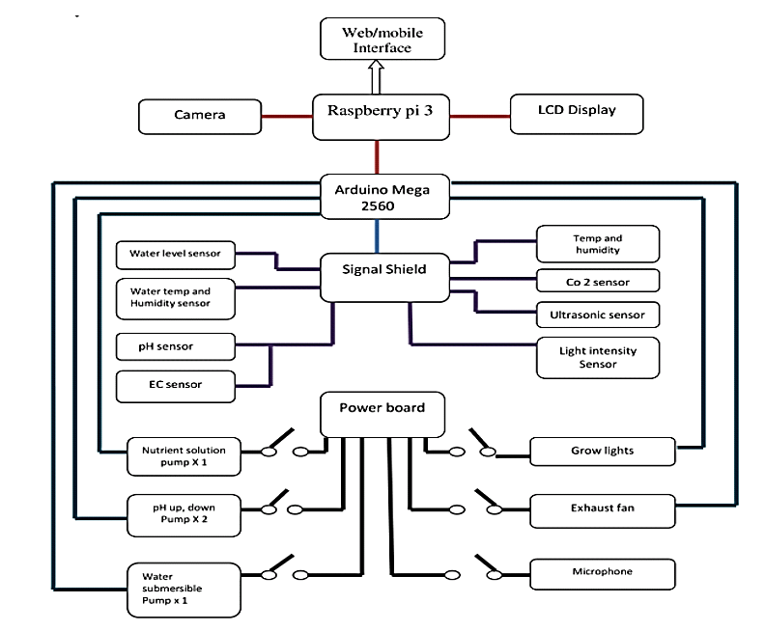
FLOWCHART
ESP-32-S2

Slide 11
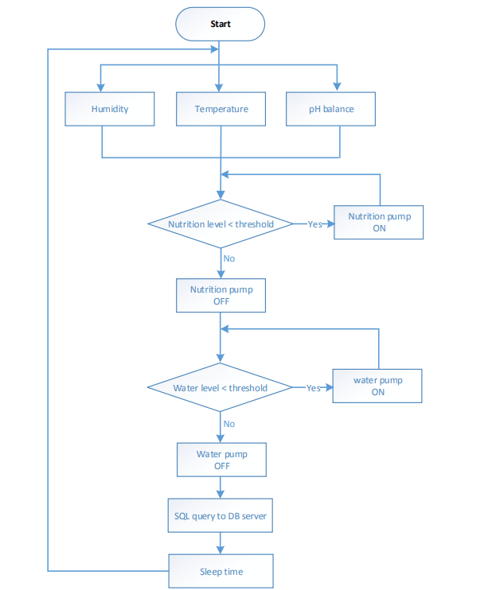
FLOWCHART OF IOT DEVICE

Slide 12
Application
The monitoring system incorporates the use of an application for mobile devices capable of showing records and visualizations from the analysis of information acquired by the built-in sensors and processed by the IoT analytics.
In addition, the app records the measurements of the environmental conditions, the status and readjustment of the pH and EC of the nutrient solution, access to the irrigation controls and the recirculation and the mixer of the system.
Additionally, the platform has a standard thermographic camera (8–14 μm); each of its captured images are transferred to the platform through an SMB server, which allows them to be viewed in the Aeroponics Monitor application.
The Monitoring application is operated by users which focuses on analysis and visualization of the behavior of the variables and the findings made by contrasting them with the RGB and thermographic images captured. and the operating status of the system and control the actions of the aeroponic system actuators in a remote way.

Slide 13
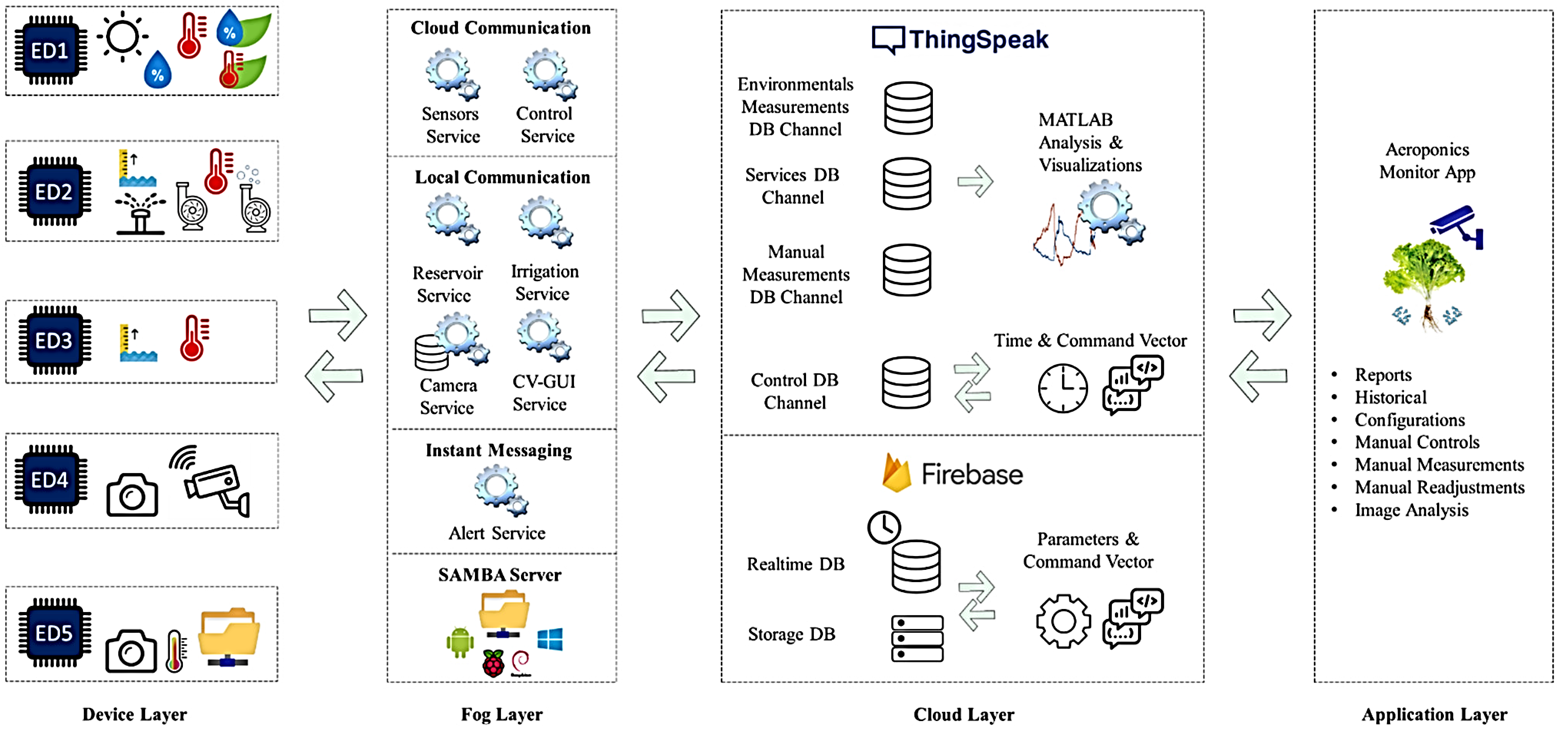

Slide 14
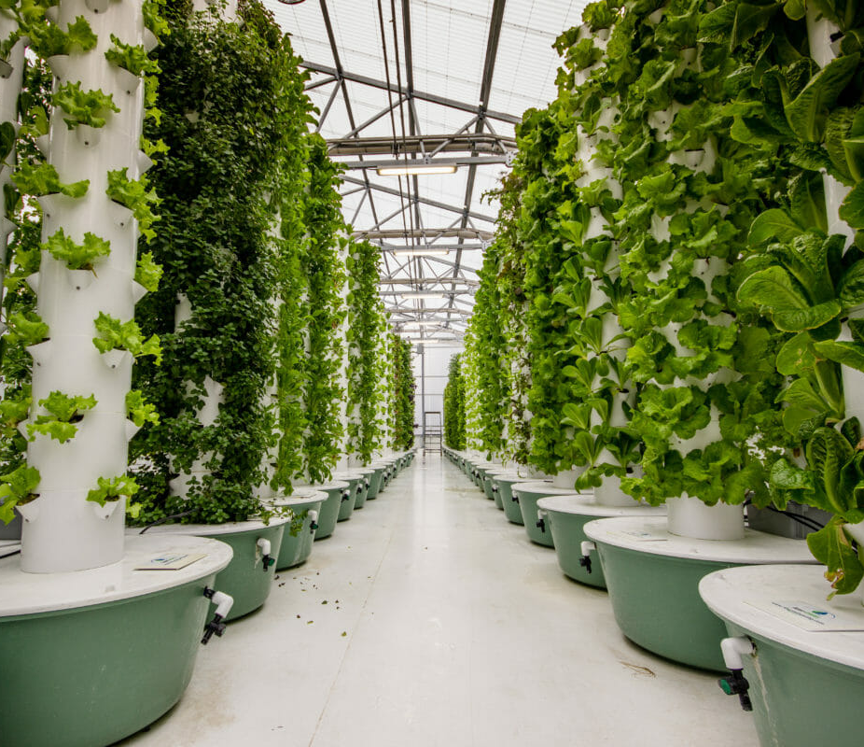
POSSIBLE OUTCOME
This system will be fully enclosed and completely detached from the outer environment. Thus, this aeroponic system can be completed monitored and regulated which can greatly reduce the practical problems associated making it a commercially viable solution.
This IOT system facilitates the management of an aeroponic greenhouse through the registration of manual procedures, the automation of the irrigation system and the monitoring of environmental variables in cultivation; all this with the support of a visualization tool from an app.

Slide 15
Reference
[1] "Climate Education for K-12," NC State University, 16 8 2010.
[2] "Progressive Plant Growing is a Blooming Business," NASA, November 30, 2007.
[3] I. Nir, "Apparatus and method for plant growth in aeroponic conditions,” July 12, 1977.
[4] L. W. V. Richard W. Z0bel and T. N. Richard F. Lychalk, "AEROPONIC GROWTH SYSTEM WITH NUTRIENT FOG STABILIZATION,” October 27, 1998.
[5] Y. W. Z. Jing Liu, "An Automatic Aeroponics Growth System Based on Ultrasonic Atomization,” February, 2013.
[6] F. A. O. J. G. M. a. G. V. A P Montoya, "Automatic aeroponic irrigation system based on Arduino's platform," September 22, 2016.

Slide 16


